Slide 1

Global Coffee Trade
Presented by :
Cindy Wong
Sandra Botica
Notes:
Good evening everyone,
For our project 3, both me & Sandra will be presenting on the data visualisation about global coffee trade.
(next)
Photo by
https://unsplash.com/@nate_Dumlao
Nathan Dumlao on
https://unsplash.com/photos/zUNs99PGDg0
nathan-dumlao-Y3AqmbmtLQI-unsplash.jpg
Photo by Nathan Dumlao on Unsplash

Slide 2
Presentation Today
Introduction & objective of this visualization ------- Cindy
Data that we collected ----------------------------------- Sandra
Analysis & Discussion ------------------------------------- Cindy
Conclusion --------------------------------------------------- Sandra
Notes:
I’ll start off the presentation with the introduction and objective of this visualisation and followed by Sandra who will be discussing on the data that we collected, analysis on the dataset will then be presented by me & Sandra will conclude our presentation.
We’ll try our best to fit all of our presentation within 10 mins timeframe.
(next)

Slide 3
OBJECTIVE OF THIS STUDY
Coffee is:-
One of the most popular beverages in the world
One of the most important commodities
Important to world’s economy
Coffee production growing interest in the economic social and environmental aspect.
Notes:
So, why coffee? In a nutshell, coffee is one of the most popular beverages in the world and grabbing a cup of coffee on the way to the office, has become a daily thing to do for many workers around the world and some reckons that it’s a trend.
With such a high demand in coffee from everyone around the world, hence coffee became one of the most important commodities and even the main source of income for the country, (next slide) i.e., Brazil, one of the top exporters, which we will discuss later in our presentation.
(next slide)

Slide 4
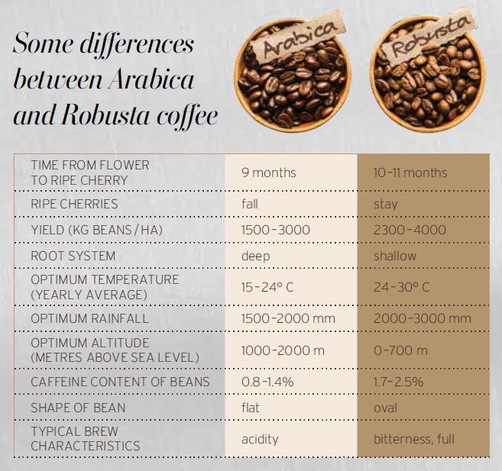
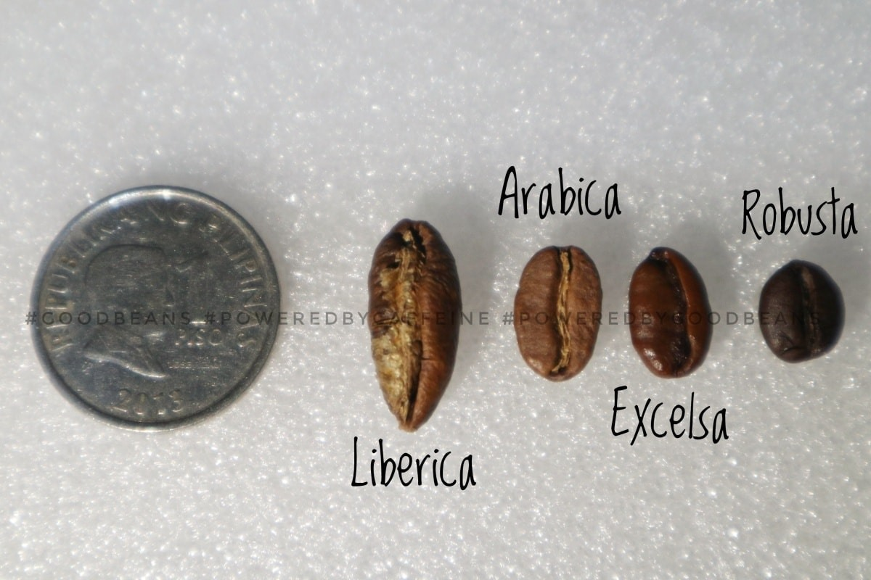
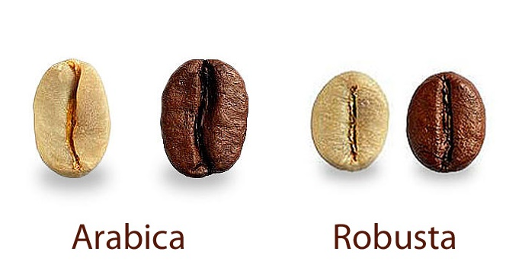
Types of coffee bean
4 types of coffee beans
Notes:
Just a basic information about coffee beans before we dive more into our dataset and visualisation/ outcome, there are 4 different types of coffee beans around the world, Liberica, Arabica, Excelsa and Robusta.
Out of the 4 types of coffee beans, the 2 main types of coffee that dominates the world coffee import and exports.
60% of the import and export are from Arabica and 40% from Robusta and this is also what our data is focusing in.
(next slide)

Slide 5
Data Story
The number of countries producing (exporting) coffee and what volume?
The number of countries buying (importing) coffee and what volume?
Price paid to growers for exporting country
Retail price in importing country
Notes:
Cindy
So, in this project, we will be discussing mainly the 4 main parts to this data story :-
The number of countries exporting/ producing coffee and at what volume?
The number of countries buying/ importing coffee and at what volume?
Prices paid to growers for exporting country over the time? and
The retail prices in importing country.
Now passing on to Sandra who will present more on the data source for this project (next)
(next)

Slide 6

Data Source
International Coffee Organization
Historical Data on the Global Coffee Trade
https://www.ico.org/new_historical.asp
Notes:
Sandra –
Started with a Kaggle website
https://www.kaggle.com/datasets/michals22/coffee-dataset?select=Coffee_domestic_consumption.csv
Then found the International Coffee Organization, historical data on global coffee trends.
Selected 4 excel spreadsheets, data from 1990-2019.
Cleaning csv
blank rows, subtitles for regions, coffee type columns.
Tried this in python and excel.
A lot of null values, but still relevant or insightful to the story.
Photo
https://www.dreamstime.com/photos-images/coffee.html

Slide 7
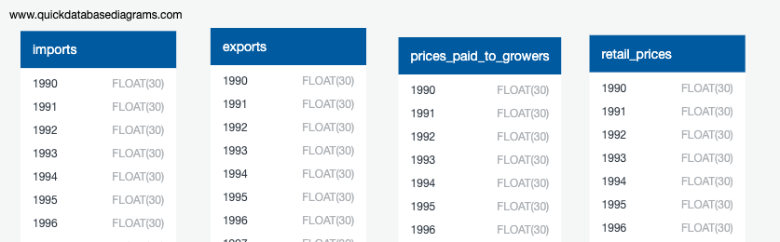
Database
QUICK DBD
Export PostgreSQL
pgAdmin4
Created 4 tables, import data from Resources files
Notes:
Sandra –
Tables created in QUICKDBD(see above) pivoted then unpivoted back to original row/columns structure.
PostgresSQL file exported to PgAdmin, cleaned files uploaded.
Goal for each table (as see in next slide) was a list of dictionaries for the API endpoint. Each row was a dictionary with Id:X,Country:X, Year:X as key:value (volume or price) pairs.
Experimented with joins of 4 tables to create 1 file for the API.
Experimented and successfully created tables with MongoDB.
Had difficulty in setting up Flask API in app.py and had to use username and password to coffee database in postgressql. Very new concept.
I wasn’t able to select/connect data using Base = automap_base() Base.prepare(autoload_with=engine) so no references to tables Coffee = Base.classes.coffee.
Hence had written app.py syntax using this methodology with no return in python experiment. Changed to reading sql.

Slide 8
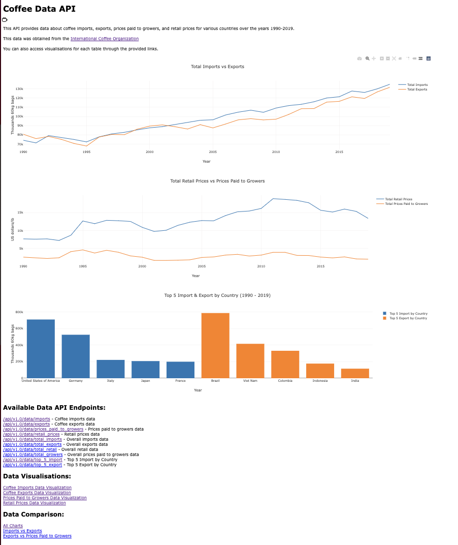
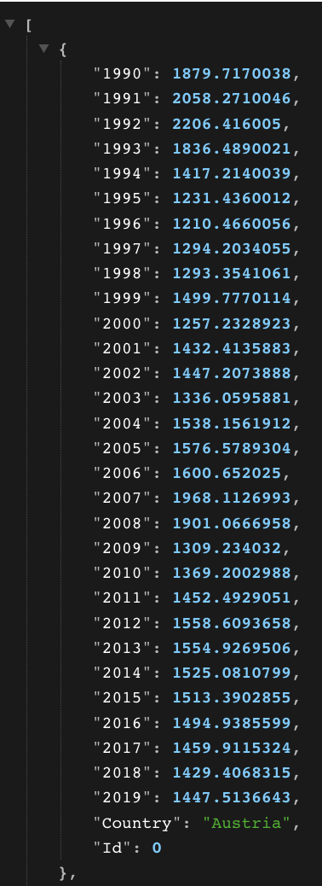
Python Flask API & Plotly
app.py
index.html
javaScript, css, html
Notes:
Sandra
Created a drop down menu to populate the plotly line graphs, as was demonstrated in classes 14-Interactive Visualisation, Lesson 3, Activity 9.
Also used json render-templates extension for html files.
Original design was for 4 endpoints, but then this changed to look at some aggregate values such as total import/export per year and mean growers and retail price per year.

Slide 9
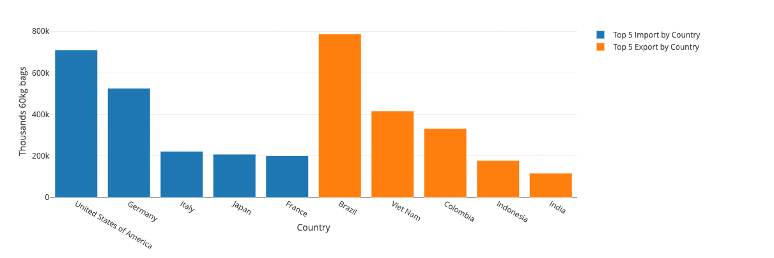
Top 5 Coffee Import & Export Country TOTAL COUNT FROM 1990 – 2019
IMPORT
EXPORT
Notes:
Cindy
From our dataset, we can spot the top 5 coffee import and export country for the period of 1990 to 2019.
Top 5 coffee importer USA, Germany, Italy, Japan & France
Top 5 coffee exporter Brazil, Vietnam, Columbia, Indonesia & India
(next)

Slide 10
TOP 5 COFFEE EXPORTER
Notes:
Cindy
Just quick slideshow showing the comparison between the top 5 coffee export country and the prices paid to their growers.
From what we can see from this dataset are:-
Main coffee exporter is mainly affected by weather and second, the ripple effect of a global economic crisis, such as 1997 – the Asian Crisis and 2007 – 2008 – The global financial crisis
(next)

Slide 11

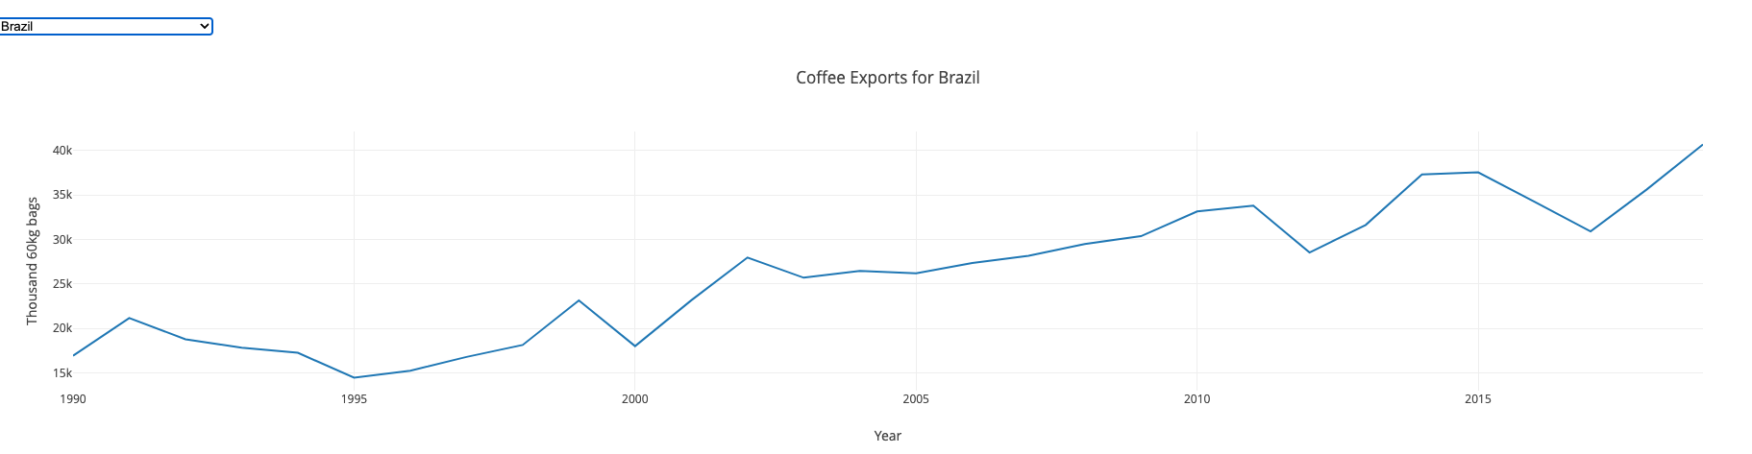
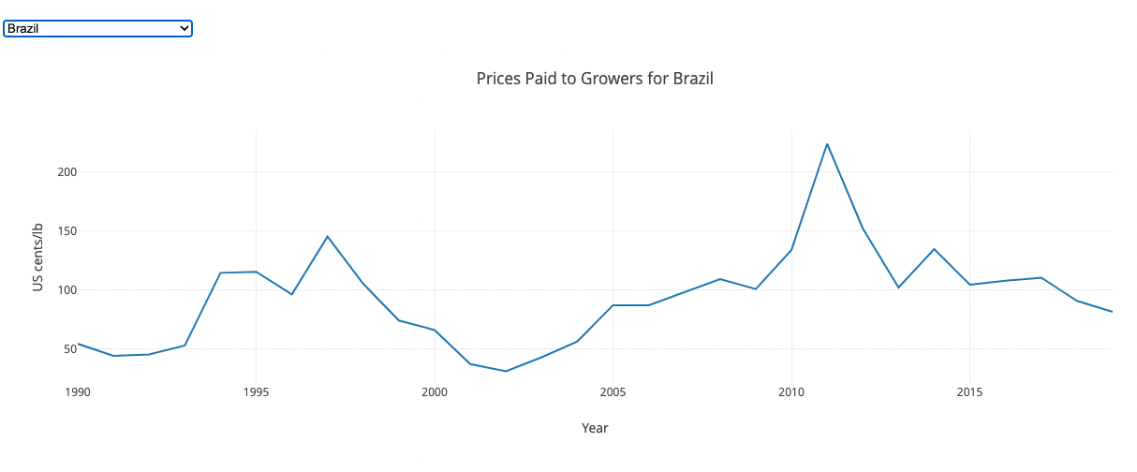
In 2014 Brazil suffered a severe drought, high temperatures causing the yield to be low.
Brazil
Top 1
“Coffee is Brazil & Brazil is coffee”
1997 – The Asian Crisis
2007 – 2008 – Global Financial Crisis
Notes:
Cindy
Brazil – The No. 1 Coffee Grower, showing the dip around 1997 where the Asian Financial Crisis happened.
In 2014, Brazil suffered a sever drought. With the extreme high temp weather it caused the coffee bean production to decrease hence the decrease in 2015 in both exports and prices paid to growers.

Slide 12
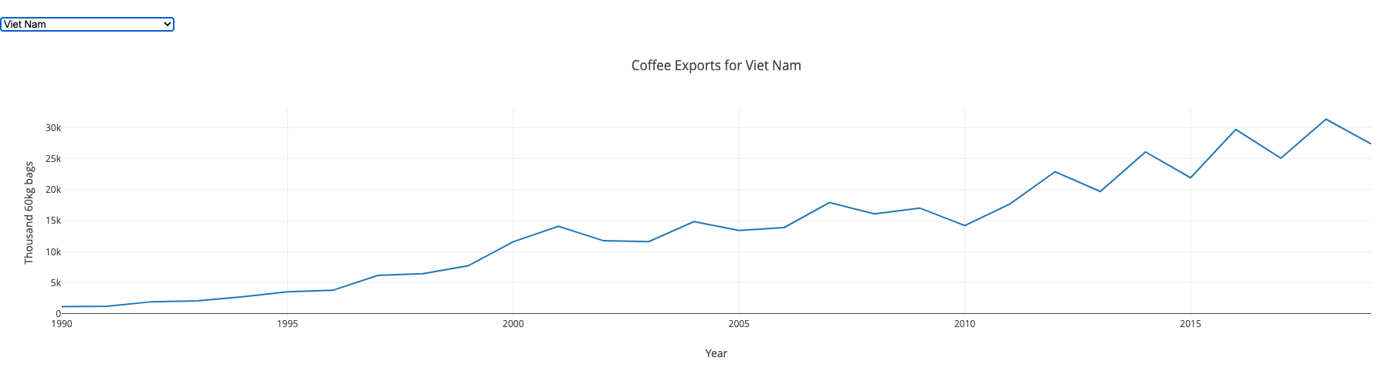
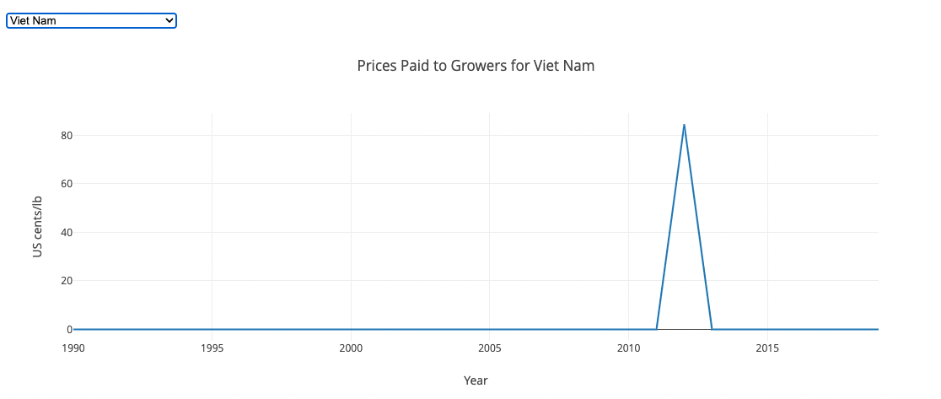
Viet Nam
Top 2
Notes:
Cindy
This data visualized our top 2 coffee exporter - Viet Nam
Note that the ”0” value in the prices paid to growers are in fact “null”, not actual $0

Slide 13
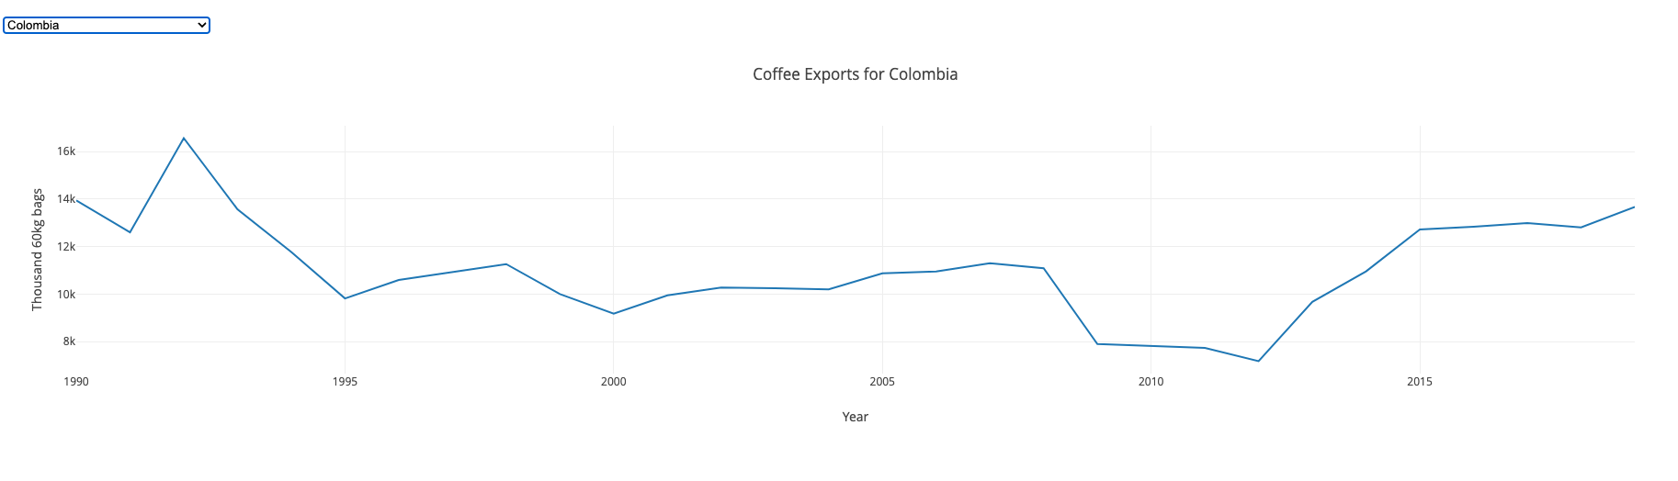
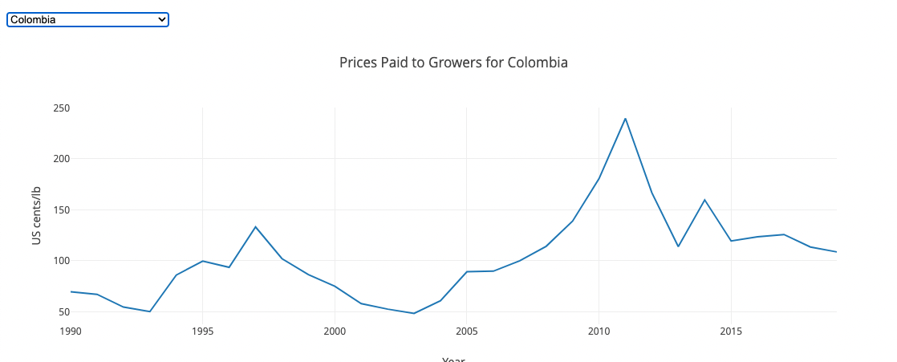
Columbia
Top 3
Jan 1999, severe earthquake struck Columbia
2007 – 2008 - GFC
Notes:
Cindy
This data visualized our No. 3 coffee exporter - Columbia
1997 – The Asian Economic Crisis causing the dip
1999 – where the severe earthquake struck Columbia and affected the coffee farm
2007 – 2008 – The Global Financial Crisis which affected the coffee exports but not the prices paid to the growers

Slide 14
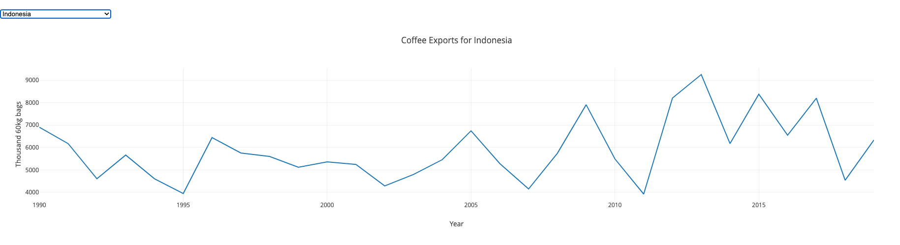
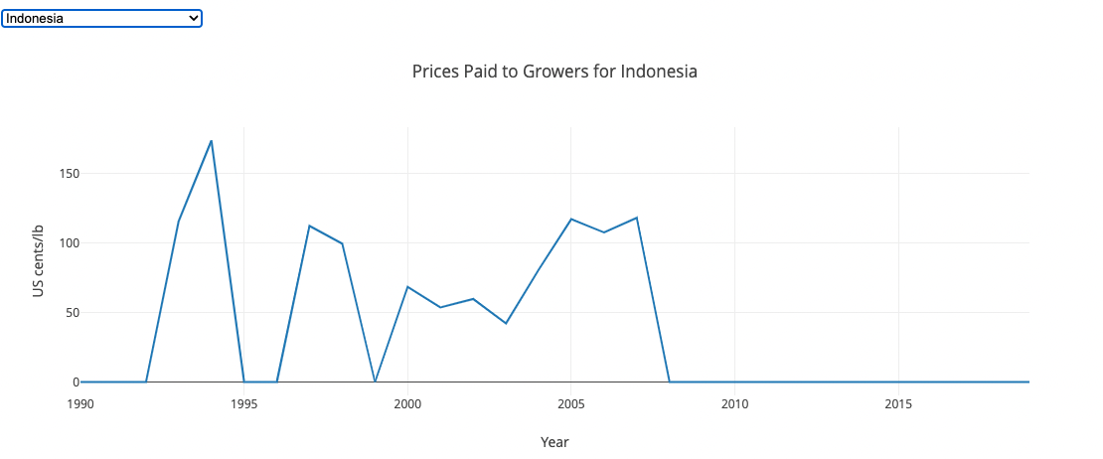
Indonesia
Top 4
Notes:
Cindy
This data visualized our top 4 coffee exporter - Indonesia
Same as Viet Nam
Note that the ”0” value in the prices paid to growers are in fact “null”, not actual $0

Slide 15
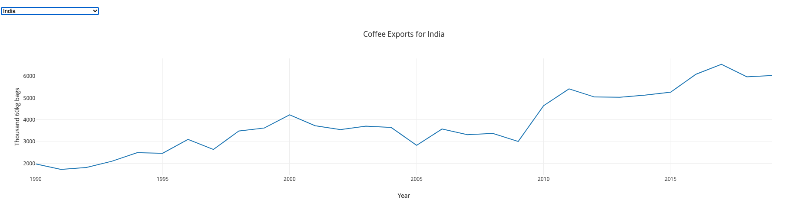
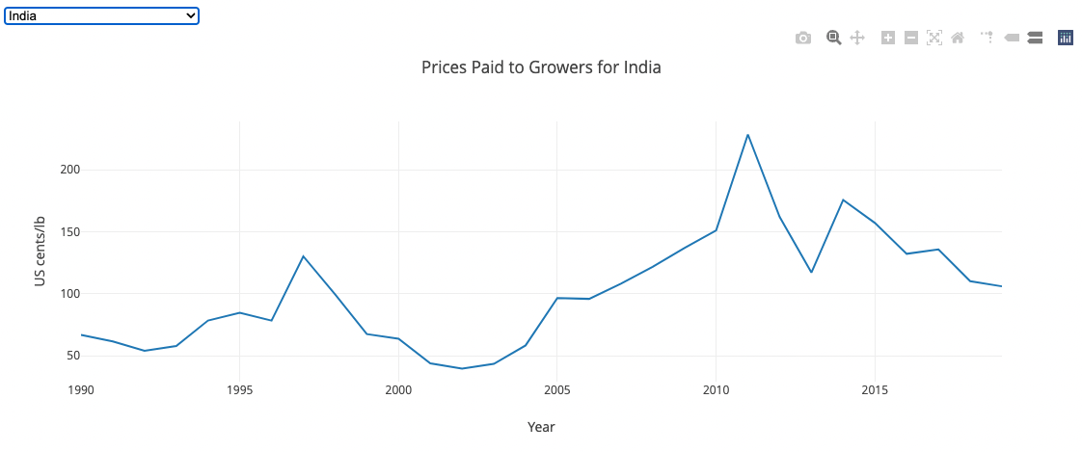
India
Top 5
Notes:
Cindy
This data visualized our no. 5 coffee exporter - India
As the data Note that the ”0” value in the prices paid to growers are in fact “null”, not actual $0.

Slide 16
TOP 5 COFFEE IMPORTER
Notes:
Cindy
Just quick slideshow showing the comparison between the top 5 coffee import country and their retail prices.

Slide 17
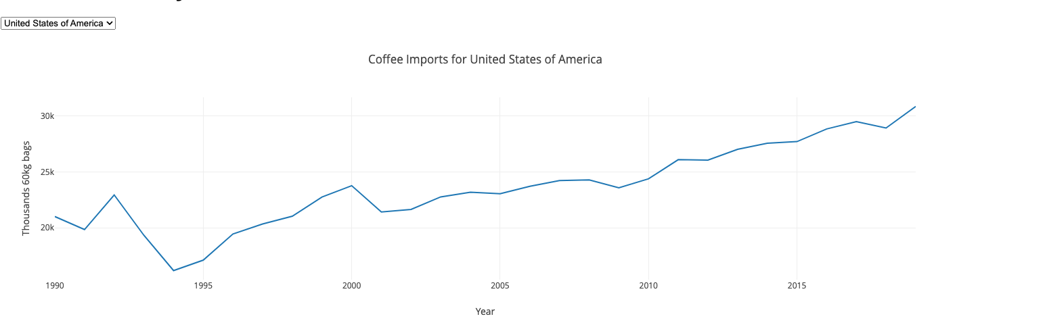
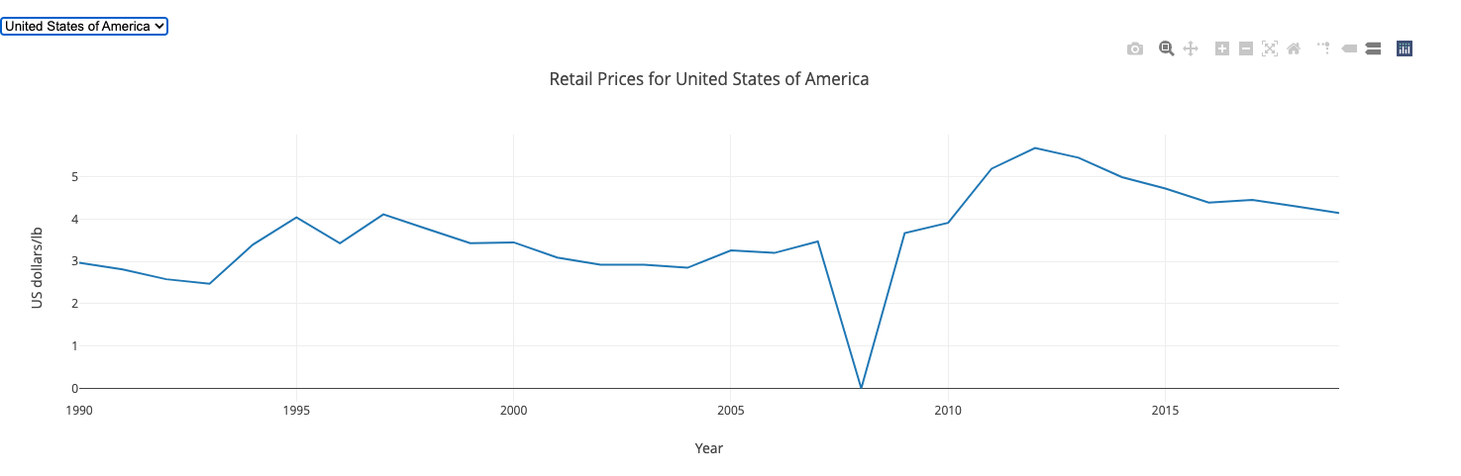
Top 1
United States
of America
** No data collected
Notes:
Cindy
This is for USA

Slide 18
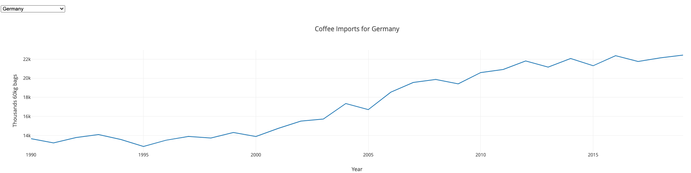
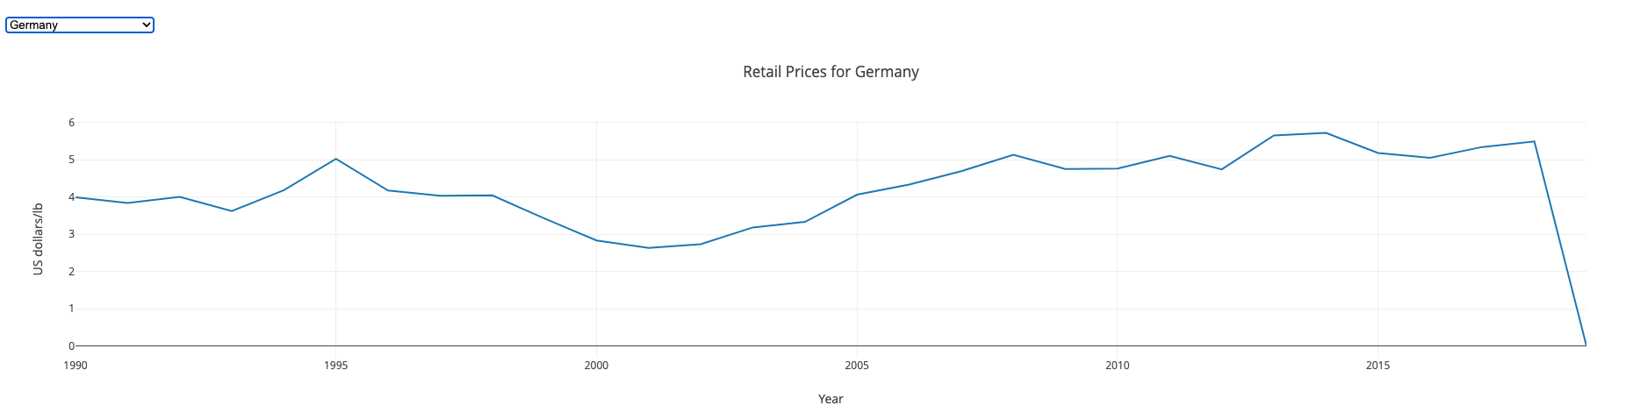
Top 2
IMPORT
Germany
Notes:
Cindy
And this is for Germany

Slide 19
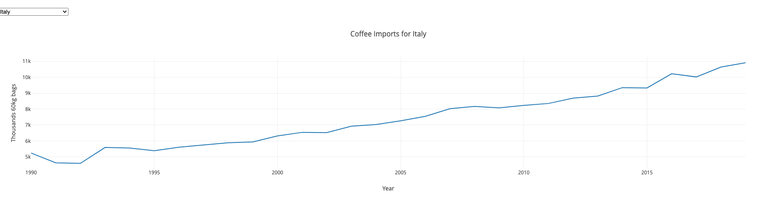
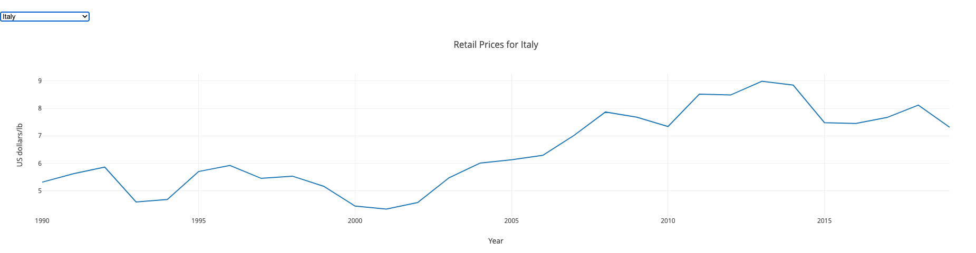
Top 3
IMPORT
Italy
Notes:
And this is for Italy

Slide 20
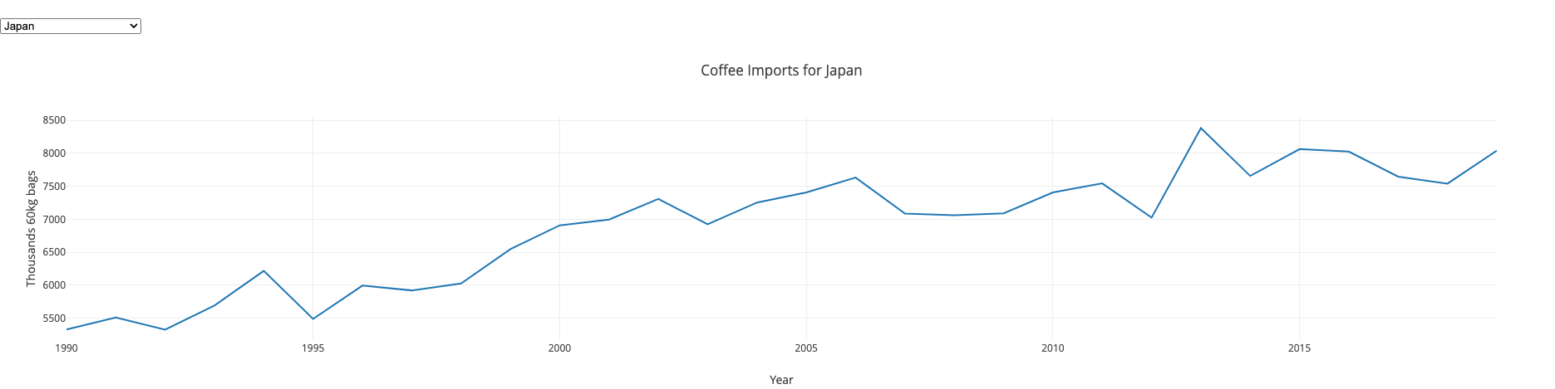
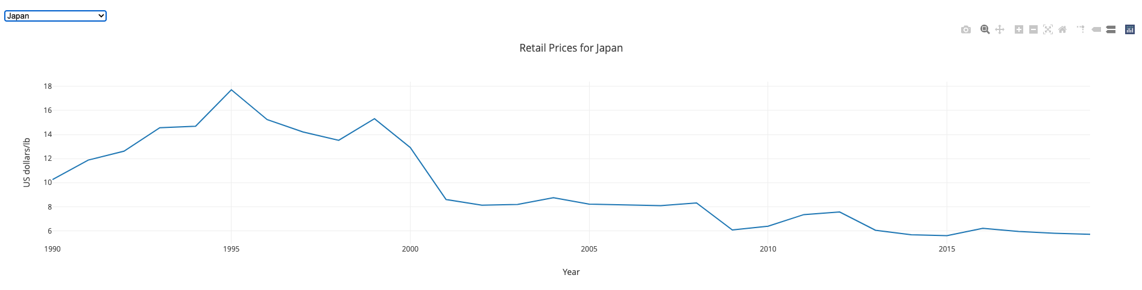
Top 4
IMPORT
Japan
Notes:
And this is for Japan

Slide 21
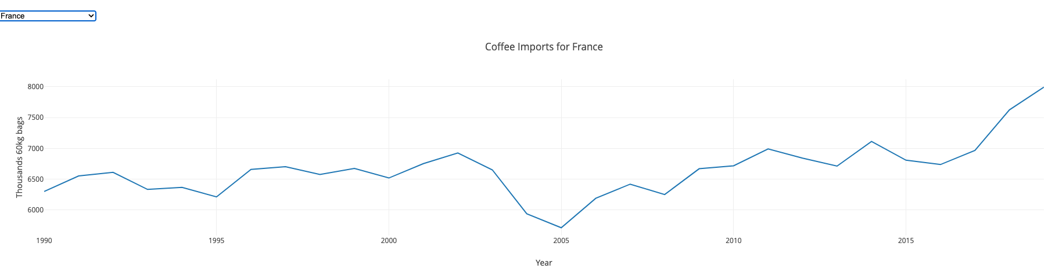
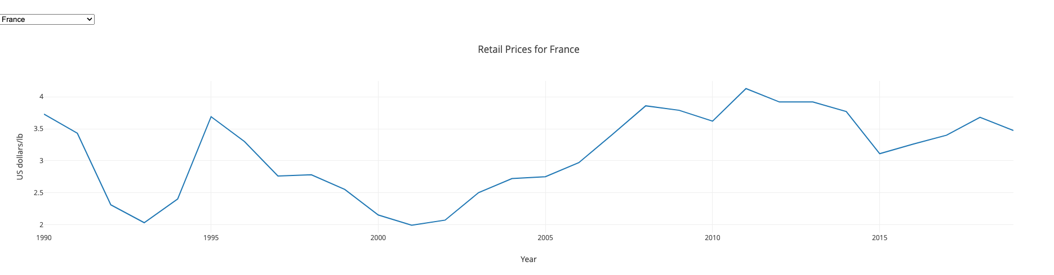
Top 5
IMPORT
France
Notes:
And this is for France
Out of the 35 importing countries, 26 of them having a rise in imports and others have flat or minimal decreasing import volume.
So from the top 1 – 4 coffee bean importing countries, we can see that the import volume is not affected by the economical crisis of the world.
(next)

Slide 22
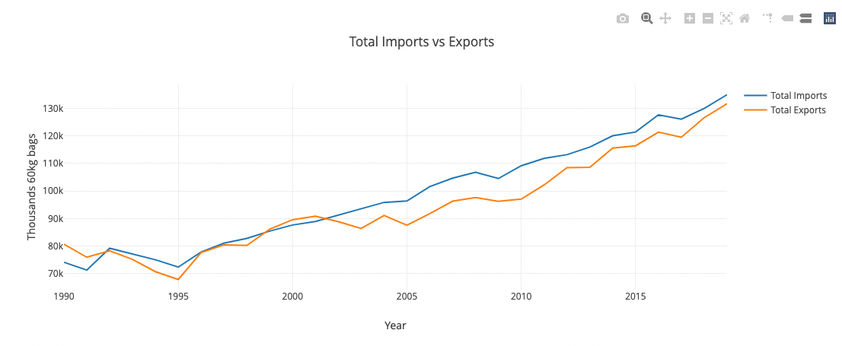
Have exports and imports risen over time?
Notes:
Cindy
So have the exports and imports of the coffee risen over time ? The answer is yes.
Now, passing over to Sandra where she will elaborate more on the dataset.

Slide 23
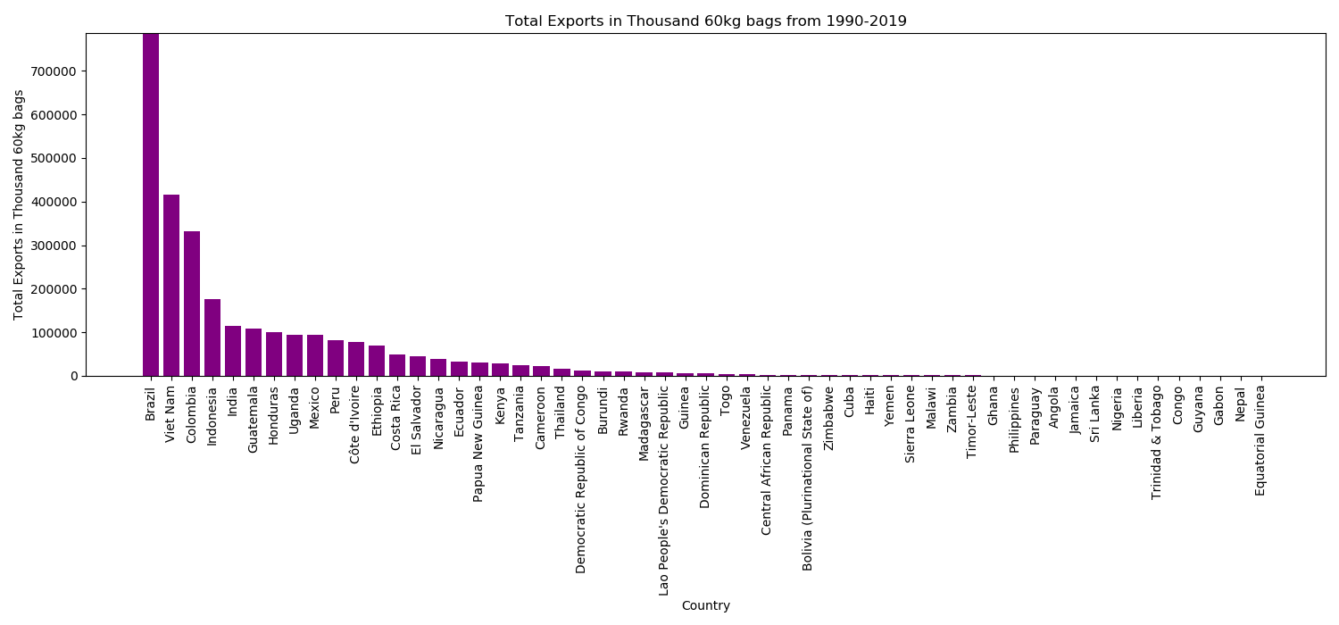
The number of countries producing (exporting) coffee and what volume?
Brazil
Vietnam
Colombia
Indonesia
Dominican Republic, Bolivia & Cuba
Top 4 price paid to growers
Jamaica Number 1 in price paid to growers
Notes:
Sandra
The number of countries producing (exporting) coffee and what volume?
Brazil nearly double in volume compared with the next largest exporter.
In this bar graph, notice the large number of small volume exporting Countries. The beauty of the ICO is the way it facilitates a large number of small to medium volume exporters to trade, encouraging small farmers and local communities to produce.
Dominican Republic, Bolivia and Cuba, all 3 are small scale exporters, but in a later slide you will see their price to growers is similar to other large volume exporters.
1990-2019
Exports (55 countries)
Countries, continents, volume in Thousand 60kg bags, Information derived from monthly reports.
(Keep in mind that 60kg is 132.277 pounds i.e. 1 kg = 2.20462 pounds)=

Slide 24
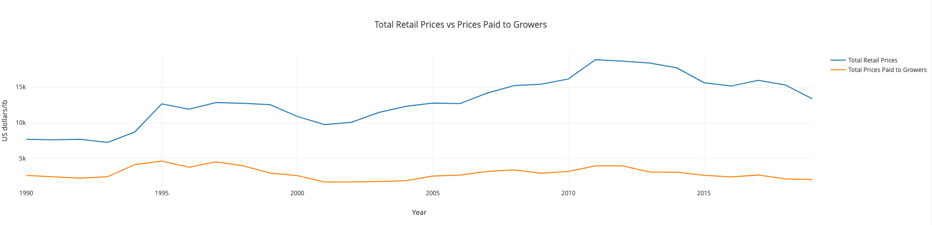
Total Retail Prices vs Prices Paid to Growers
Green coffee prices have almost doubled (up by 96%)
Brazil suffered a major climate crisis in key coffee growing regions
Due to soaring global freight costs, some suppliers have also added freight levies up to 12%
Notes:
Sandra
Blue line, mean retail price per year, mirrors price paid to growers up to ~2002, then rises, possibly due to transport/wages/rent etc as cost for a coffee retailer.
Sad to see the price paid to growers is not rising.

Slide 25
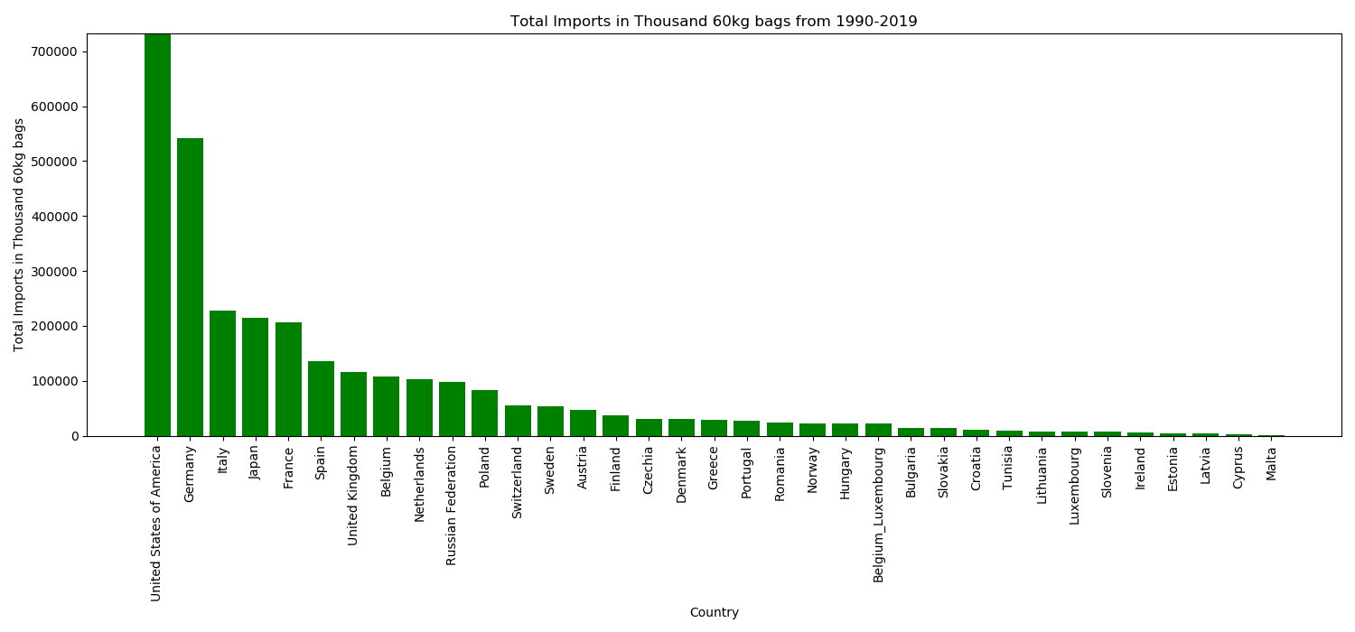

The number of countries buying (importing) coffee and what volume?
United State of America
Germany
Non _European countries
Notes:
Sandra
The number of countries buying (importing) coffee and what volume?
Of the 35 Countries in this dataset, 32 are European importers, with the largest volume of imports from the USA. Japan and Tunisia are the other 2 non-European importers as shown by the 3 coffee beans.
1990-2019
Imports (35 countries)
Countries, continents, volume in Thousand 60kg bags, Information derived from monthly reports.
(Keep in mind that 60kg is 132.277 pounds i.e. 1 kg = 2.20462 pounds)

Slide 26
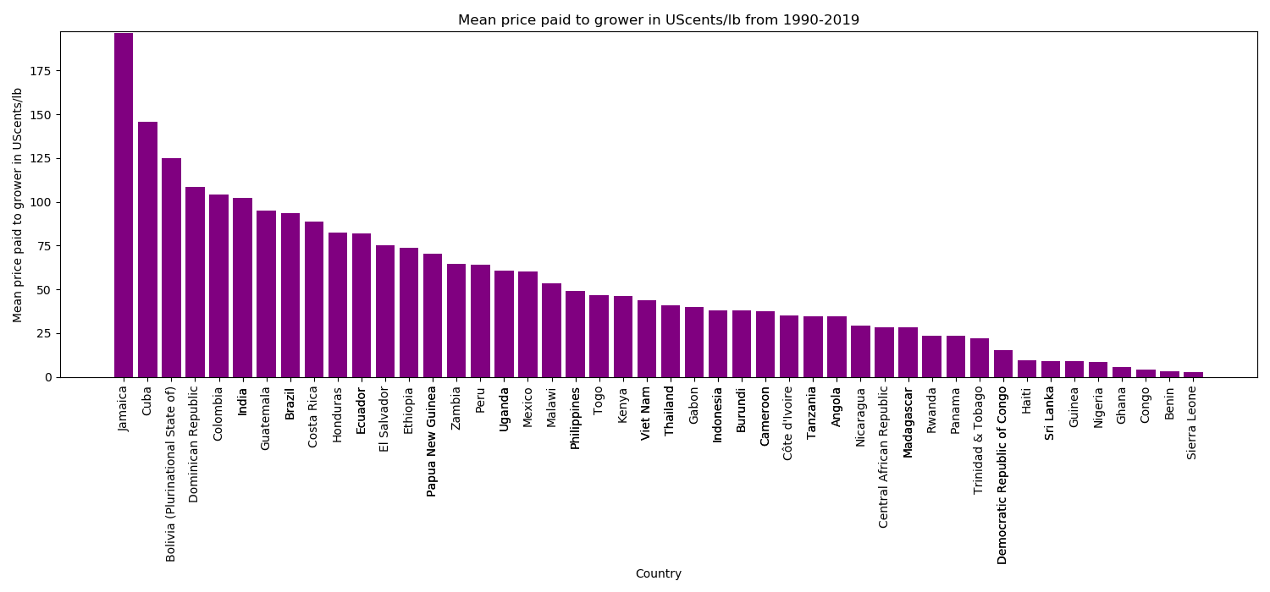

Price paid to growers.
4 main exporters
Indonesia
Notes:
Sandra
The star icon is for the 4 main exporters (minus Indonesia who are not in this plot). Considering the volumes they export, it is interesting Vietnam don’t pay growers more.
When you scroll through our plot visualisation there are
Spikes 1997 2011
Dips >1998 and after 2011, which would benefit from deeper investigation.
Prices paid to growers in Bolivia, Togo and the Dominican Republic are on a steady incline.
Burundi 2010, no trade data? did trade stop for those countries?
Other countries missing years of data
Price paid to growers (62 countries)
US cents/lb as an annual average. (Keep in mind that 60kg is 132.277 pounds i.e. 1 kg = 2.20462 pounds)
Avg price paid to to grower at farmgate
OR min price guaranteed by the gov to the grower by form and weight reported in the national currency in which the coffee is purchased, converted to US cents/lb.
Coffee-type
Colombian Mild(27/62 countries)
Other milds(27/62 countries)
Brazilian Naturals(27/62 countries)
Robustas(27/62 countries)

Slide 27
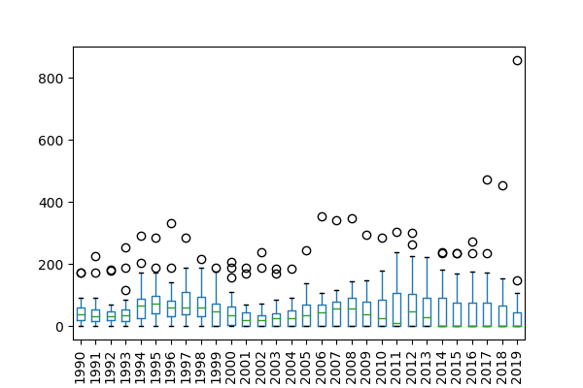
Price paid to Growers
Notes:
Sandra
Box plot to look at distribution of data/variability/dispersion for price paid to growers and notice the rise and fall of the interquartile ranges and the outliers paying higher prices to growers. Notice the smaller interquartile range in 2019, might this indicate a smaller variability in negotiating prices paid to growers.

Slide 28
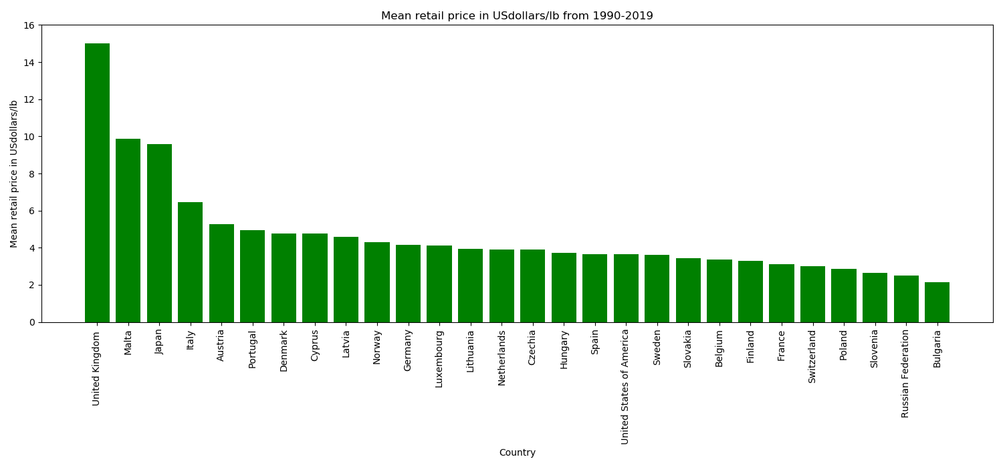
Retail price
Notes:
Sandra
Does the higher retail price paid in the UK reflect the economic of the country to charge higher prices or do they have higher overheads that require higher retail prices.
Retail price (28 countries)
(Global price of coffee)
US $/lb as an annual average.
Price paid by consumer to commercial distributor outlet.

Slide 29
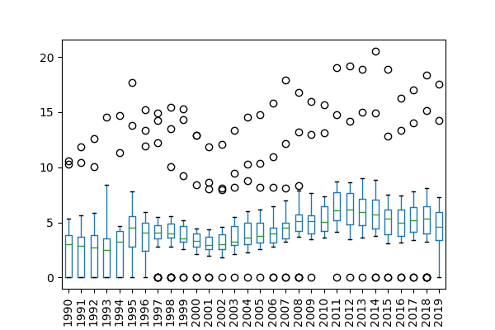
Retail price
Notes:
Sandra
Box plot to look at distribution of data/variability/dispersion for retail price and notice the rise and fall of the interquartile ranges and the outliers having low and high variability in retail prices.
Also, interesting to see the larger interquartile range in 2019, indicating a greater variance in retail price.

Slide 30

Questions
&
Limitation of this data
Notes:
Sandra
Initial story
Market analysts and researchers can consult this data as an indicator of prices paid to farmers in coffee producing countries.
Commodity experts can create statistical reports using this data.
Understand the top 5 importing and exporting countries.
Questions we still have about the Global coffee Trade.
Investigate countries and volumes of coffee type e.g. arabica vs robusta.
Analyse regional exports e.g. Africa, Asia/Oceania, Central America & Mexico and South America.
Impact of adverse weather and global fertilizer costs.
Understanding how retail prices were determined.
Amount of trade in dollars using data from the World Bank.org
Limitations with the data
Small number of countries
Use of pounds and Us cents/lb
Understanding the annual average of price paid to grower as references a price guarantee by governments to growers.
ICO’s method of aggregation of values for analysis. Does it represent production on the ground within each Country?

Slide 31

CONCLUSION
Notes:
Sandra
This project has revealed the Global demand for coffee does not appear to have been affected by decelerating global economic growth or rising cost of living.
Might data from 2019 to present reveal a different trend?
Does anyone have any questions, or like to share what they enjoyed or will remember about this presentation?

